Slide 1
Consolidated slide-deck for member organisation presentation
Australian Government Linked Data Working Group Annual General Meeting 3 August 2017

Slide 2
The Department of Finance, Linked Data, and Semantic Ontologies.
For Whole of Australian Government Transformation and Core Business
Notes:
The Department of Finance is the agency responsible for budget policy and government financial accountability – and for efficiency and transformation of the whole-of-government generally. The Department of Finance had some experience with linked data, and to a lesser extent semantic ontologies, when it looked after data.gov.au – when these activities moved as part of machinery-of-government changes so did those with the background. Finance can therefore be considered as similar to a new-comer in this field.

Slide 3
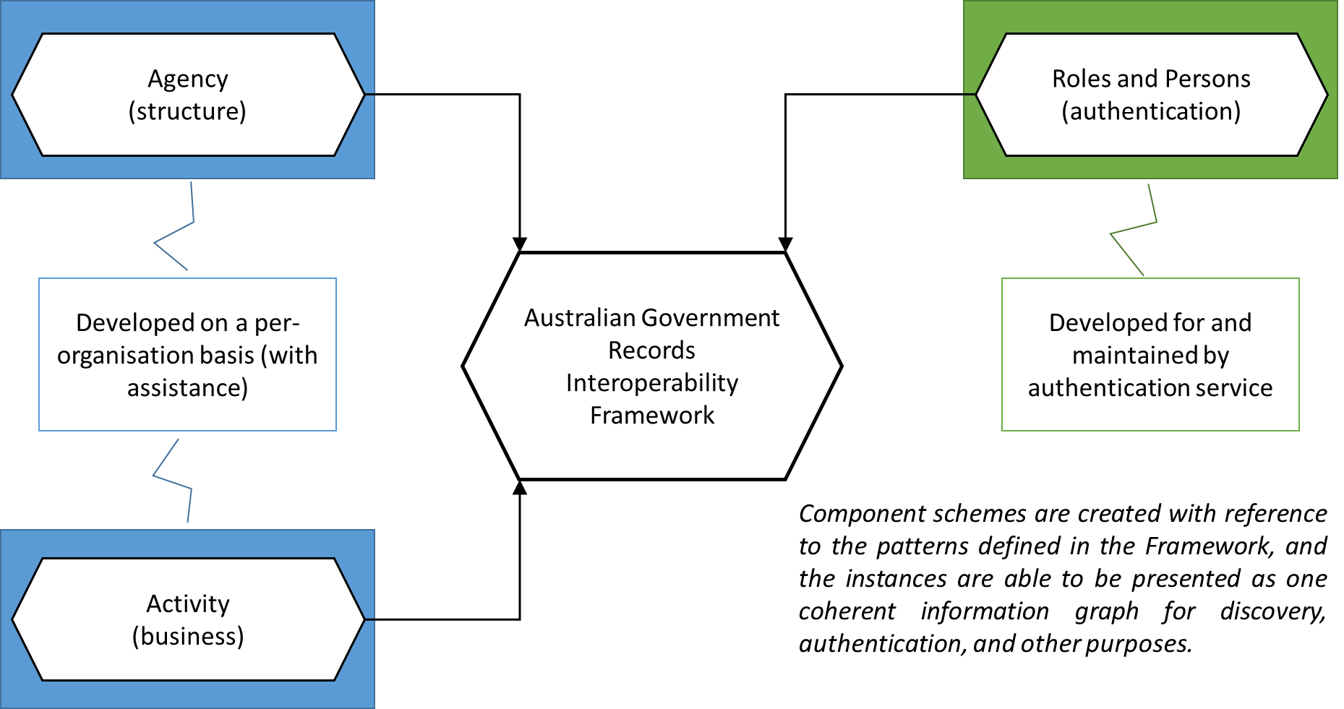
Current initiatives at the Department of Finance
Australian Government Records Interoperability Framework
“represent the structure, functions, and activities of the Australian Government”
Notes:
Linked data related work at the Department of Finance is currently centred on the AGRIF – which is being developed in order to enable the Digital Records Platform which was recently funded as part of the Transformation and Innovation stream of the APS Modernisation Fund.
The Framework intends to describe the structure, functions, and activities of the Australian Government so that this information can be used to contextualise the records created as part of government business processes. What are these records? Legally-speaking everything that isn’t exempted specifically in the Archives Act; but initially the focus is on those records that are typically ineffectively managed – natural language documents like email, business cases, draft policy, and so on. Part of the work involved is in building the capability of the APS to construct and maintain something like AGRIF – so it is not simply a technical or technological task.
That being said it is a fairly complex modelling task as it will need to consider a lot of existing, non-semantic or weakly-semantic, description of structure and business.
So far the “core” of the ontology – those elements that relate closest to describing information for the description and management of records – has been drafted. Work proceeds on the next stage which is to start mobilising experts in our four pilot agencies: Finance, NAA, APSC, and PM&C.

Slide 4
Future opportunities at the Department of Finance
Secure Information Sharing Capability
Australian Government Organisation Register
Finance Staff Directory
Shared Services for Enterprise Resource Planning
Caveat: Maybe! (all of these other programs have existing work and their schedules)
Notes:
Many people have noticed the need for an authoritative, persistent, rich, and most of all maintained representation of the Australian Government.
There have even been prior attempts!
In engaging with stakeholders within Finance on the AGRIF work it has been noted that it might be entirely possible to use parts of AGRIF to support business activities that are not strictly records management related (although obviously they create records). As a result of this we are managing any new expectations without trying to discourage people from investigating any opportunities.

Slide 5
ABS and Government Linked Data Presentation for AGLDWG AGM
Laurent Lefort
August 2017

Slide 6

Semantic Technology: Advantages for Official Statistics
Flexible and responsive data structure
Reusable standards for multiple purposes
Easy exploration of multiple dimensions
Analysis of the network structure of data
Machine reasoning and inference
Demonstrated in GLIDE (Graphically
Linked Information Discovery
Environment) prototype –
analytical platform for data
exploration and visualisation
Notes:
See presentations by Ric, Siu-Ming
See description in submission to Productivity Commission http://www.pc.gov.au/__data/assets/pdf_file/0017/203183/sub046-data-access.pdf

Slide 7
ABS activities
Beyond the Emerging Data and Methods section (where I work)
w/ Business modelling community working for ABS’s Statistical Business Transformation program: e.g. review of XKOS
Geospatial solutions (ASGS, UN GGIM Global Statistical Geospatial Framework): value of having ASGS linked data with a GeoSPARQL-based or/and XKOS-based representation
solutions for managing longitudinal evolutions of datasets (units), classifications
Research on benefits of using linked data approaches to adapt/enrich unit/variable-centric data management processes: emerging (big) data for official statistics, (knowledge) graph analytics
Freight telematics data, Longitudinal business data (structure, performances and export)
Toolchain supporting agile development, on demand 'multi-cube cubes' : ontology documentation hub (200+ ontologies/vocabularies), XKOS classifications utilities, TARQL
Participation to W3C Spatial Data on the Web working group,
Graphical representation of the ontologies (differences between 'old' SSN and new SSN) https://www.w3.org/2015/spatial/wiki/Mapping_Table
Interest in proposed joint OGC-W3C Spatial Data on the Web working group, especially work on Statistical Linked Data Best Practices
Notes:
Australian Bureau of Statistics With Bureau of Infrastructure, Transport and Regional Economics
Aim to understand pattern of movement of freight and utilisation of infrastucture for planning (roads, warehousing, fuel), productivity analysis, regional development
Using linked data methods for linking and analysing
In-vehicle telematics from 10-20 freight haulers
Freight transactional data
Regional socio-economic data
Contact: Ric Clarke (ABS)
United Nations Committee of Experts on Global Geospatial Information Management (UN-GGIM)

Slide 8
Areas of research and (shared?) interest
Barriers to solutions deployment, adoption by developers, skill shortages
Agility: ability to rapidly adapt/reuse existing ontologies, to write (or generate?) SPARQL queries quickly, to define ‘generalisation’ processing chains (to reduce detail in data)
Porting of ‘business rules’ into linked data environment
How to successfully produce and publish open standards
Going beyond consuming code lists and/or classifications ‘one at a time’
To counter data feudalism,
To handle concept drift/changes of classifications over time
Benefits and limitations of 'schema.org-isation' of ontologies/vocabularies
Feasibility/attractiveness of JSON-LD ‘stack’ for GeoJSON, Prov, SDMX-JSON, SSN/SOSA, other OGC standards
Knowledge graph extraction
and new methods!
Policy environment
W3C working groups not addressing policy-connected issues (e.g. data privacy, confidentialisation)
Notes:
ODI:
https://theodi.org/blog/invitation-to-tender-companies-experienced-with-developing-open-standards-for-data-to-document-their-tools-and-processes
NZ
Linked Data for Interlinked Local Government http://www.algim.org.nz/globalassets/whitepapers/linked-data-white-paper-final.pdf
Discussion on your JSON is not my JSON at https://www.w3.org/2016/11/sdsvoc/report
JSON-LD users http://www.lcaforum.ch/portals/0/df64/DF64-04_Srocka.pdf

Slide 9
Taking advantage of Linked Data? 3 August 2017

Slide 10
Who is PSMA?
Unlisted public company owned by governments
Goal: broad and sustainable access to high quality location data
An independent self-funded business

Slide 11
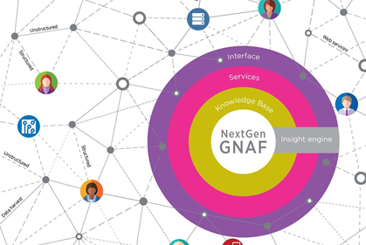
Why Linked Data?
There’s a wealth of knowledge out there
We want to participate in the creation of an ecosystem of linked knowledge
Everything happens somewhere!

Slide 12
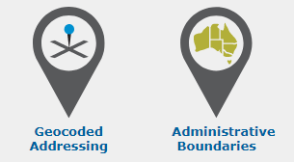
What we’re doing…
Publishing some of our open data as LOD this financial year
Investigating LD for broader applicability to our products and processes

Slide 13


Machine-executable records authorities
Tatiana Antsoupova, Assistant Director, Information Governance
AGLDWG, 3 August 2017

Slide 14

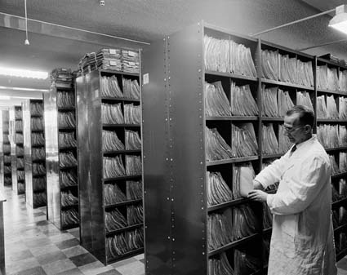
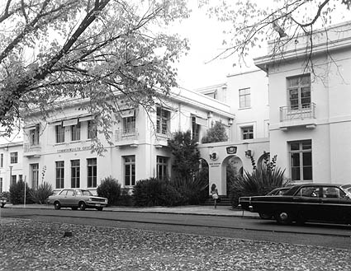
N
An executive agency in the Attorney-General’s portfolio
Empowered by the Archives Act 1983
Responsible for authentic, reliable and useable government information
Identifies ‘retain as national archives’ records and data and authorises destruction of the rest
Archives’ holdings preserved in perpetuity enable transparency and accountability of the government; protect rights and entitlements of Australians and maintain evidence for the collective memory of the nation
National Archives Preservation Facility, Mitchell, 2017
File room in a Federal Government office in Melbourne, 1960, NAA, A1200, L34711
East Block, Commonwealth Offices, Parkes, Canberra, 1972. Now National Archives Office. NAA, A6180, 2/5/72/19

Slide 15
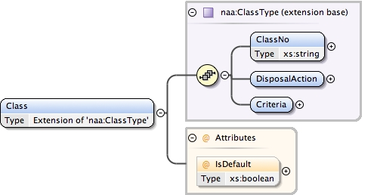
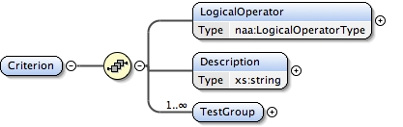
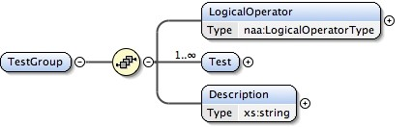
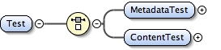
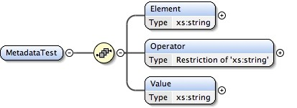
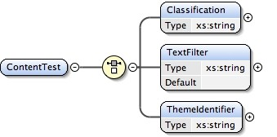
What does a records authority tell us?
For the purposes of this agency
while performing this kind of function
records of this type
are associated with this disposal class

Slide 16
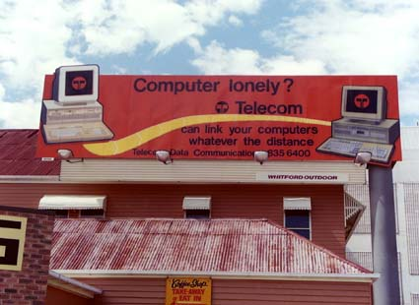
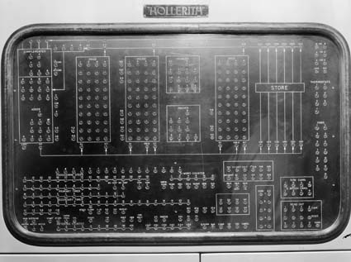
Machine-executable schema documentation addendum May 2017
Semantic data model for a test group and the formula:
ELEMENT – RELATIONSHIP – QUALIFIER, [including DOCUMENT TYPE(s), eg EXAMPLE(s)]
Arranging [QUALIFIER: ACTIVITY] [implied ‘of’ RELATIONSHIP] visits [ELEMENT: EVENT] by [RELATIONSHIP] royalty [QUALIFIER: AGENT/SIGNIFICANCE INDICATOR]
Agendas [QUALIFIER: DOCUMENT TYPE] and [RELATIONSHIP] minutes [QUALIFIER: DOCUMENT TYPE] of [RELATIONSHIP] international [QUALIFIER: GEOSPATIAL/SIGNIFICANCE] committees [ELEMENT: AGENT]
Links to ontologies
Control panel of a computer, Statistician's Branch, Treasury, Canberra, 1959, NAA, A1200, L31046
Sign advertising Telecom computer links, Stones Corner, Brisbane, 8 September 1987, NAA, J2364, 9324/2

Slide 17
ABR & SBR opportunities - a virtual register for business data - Australian Business Register Standard Business Reporting

Slide 18





The ABR story
Integration and availability of business information
Then - 2000
Now - 2017
Future 2018 - 20 +
DHS
ASIC
ABR
ATO
DIIS
ATO
APRA
ABR
ABR
Government
Government
Government
Business
Business and Community
Business and Community
ATO only
Multiple sources of data
Business information is duplicated across all level of government
Single virtual register
Connecting business identity information across government
A source of business information
272 registers are run across 96 federal agencies
Access limited and difficult to obtain
500+ agencies download week old bulk ABR data
ABR “live” for all agencies
Live access to a single source of truth for core business information
Services to
Agencies
Duplication of effort and functionality across all levels of Government
Limited visibility of business information
Businesses need to update information in multiple registers
Business details are maintained automatically
Services to
business
Confusion having to navigate agency information and forms
n/a
517 million searches to ABN Lookup annually
Integrated source of business information
Community access
Community able to see GST status and other business details

Slide 19
The SBR story
SBR was established to create a common understanding of information exchanged by business and government; in order to reduce the reporting burden for business. The ultimate goal is to make it faster, cheaper and easier for business to prepare and report obligations to government.
SBR now
SBR future
The SBR Taxonomy is a collection of data elements that may be required to be reported by business to government agencies.
Flexible technology options
Continuous assurance
Data sharing, productivity + innovation
Future SBR seeks to expand participation through:
Federated domains
A core domain for business identity data
8,000+ data elements in the SBR Taxonomy
11 participating agencies
Credit &
Insurance
Ontologies per domain
Party
Economic
Mgt
Core entity domain
Business
Acct &
Financials
Labour
Relations
Gov’t
Financial
Assistance
Education
& Training
Revenue
Collection
Flexibility
Scalability
Education
domain
Health domain
Taxation domain
Other…

Slide 20
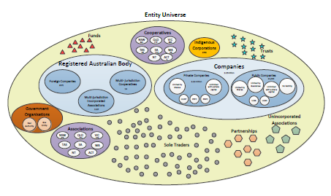
Virtual register
Virtual Register
SBR enables a core domain for business identity metadata
The entities involved in business are managed by approximately seven different entity registers
A virtual register could provide a single, central view of a business
What?
A core set of business identity information
Simplified, reusable and extensible data models
Context and syntax neutral metadata
Extensible over time
Why?
Information is an asset!
Common vocabulary and data definitions support B2G and G2G data sharing
Supports the ‘Tell Us Once’ concept
Supports the linking of various business identifiers
How?
Using semantic technologies to achieve interoperability between heterogeneous systems
Looking to linked data to achieve this
Core domain needs validation and buy-in across government

Slide 21

Questions
Semantic: katina.chambers@ato.gov.au
Technical: benjamin.burrough@ato.gov.au

Slide 22

Geoscience Australia – who and what
Federal agency within Dept. of Industry, Innovation & Science
Government's technical adviser on all geoscience; custodian of geographic and geological data & knowledge of the nation
Formed from merger of Australian Surveying and Land Information Group (AUSLIG) & Australian Geological Survey Organisation (AGSO) in 2001
http://www.ga.gov.au
Strategic Priorities:
Building Australia's Resource Wealth
Ensuring Australia's Community Safety
Securing Australia's Water Resources
Managing Australia's Marine Jurisdictions
Providing Fundamental Geographic Information
GA now delivers MH370 data

Slide 23
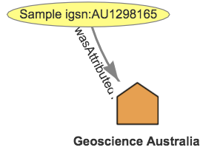
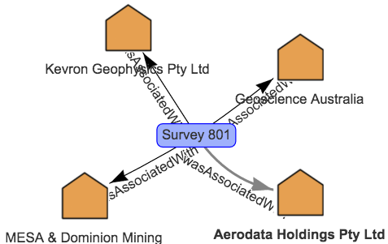
GA’s recent LD activities
Samples metadata out via LD API for IGSN community:
http://pid.geoscience.gov.au/sample/AU1298165
LD API for Surveys for internal and external use, including LD within scientific data file s(netCDF):
http://pid.geoscience.gov.au/survey/
Semantic Web data model for all GA public data:
http://pid.geoscience.gov.au/def/ont/gapd
Semantic Web graph version of the LINK:
http://link.fsdf.org.au (graph itself not yet public)
Implementing a LD framework for agency-wide provenance:
“Org prov plan”: https://publications.csiro.au/rpr/pub?pid=csiro:EP153321

Slide 24



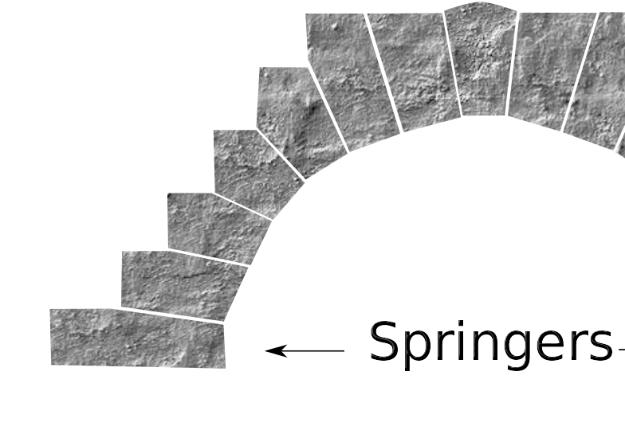
GA’s planned future LD activities
eCat + LD
Contributing to all-of-gov LD:
Support for the LD WG
Implementation of some keystone datasets (Gov orgs)
Demonstration of LD tools & techniques – APIs vocs onts
Supporting agencies in our portfolio
LD PIDs for state agency spatial data
Extending LD via research
Participating in a PROV Pingbacks testbed
Legacy catalogue & LD integration
International LD collaboration
Research Data Alliance, W3C

Slide 25
Linked Data and Semantic Ontologies in DHS
clarity | meaning | direction
Presented by Brigette Metzler
August 2017

Slide 26
About the Department of Human Services
The Department of Human Services delivers 126 services to the public and third parties on behalf of 14 government departments.
The services we provide touch the lives of 24.6 million Australians.

Slide 27
What DHS is doing in the sphere of linked data and ontology
The metadata and ontologies team is working towards developing stronger taxonomies and linking the taxonomies through an ontological framework.
We are continuing work on finding suitable platforms to capture this.

Slide 28
Future work
Several areas of the department are working on what might be considered ontological frameworks of our work.
The future focus will be on securing appropriate an appropriate platform for this work and ensuring the integrity of the underlying framework.

